Slide 1
SRM BUS RESERVATION SYSTEM
OBJECT ORIENTED PROGRAMMING USING C++
CSE-206L
CSE-V
GROUP-8

Slide 2
Contents:
INTRODUCTION
3
FEATURES OF THIS PROJECT
4
FUNCTIONS USED IN THE CODE
6
OUTPUT
7
CONCLUSION
14

Slide 3
INTRODUCTION
3
This is a simple Bus Reservation System programmed using CPP language.
This program allows the user to add bus details such as bus number, driver details, arrival and departure time, route etc,
The user can reserve a bus seat according to the vacant seats available.
One can check for a list of vacant seats on a bus.
It also allows the user to see the available buses.
This is a simple implementation of CPP code using class.

Slide 4
Features of this project
Add Bus Information : This feature allows you to install a typical bus information before it can be reserved by the passengers or shown in buses available. It includes the bus no., driver’s name, arrival time, departure time and destination (from and to) of the bus.
Reservation : This feature is very simple; it includes the bus no., seat number and the passenger’s name. The seat number of the particular bus is reserved under the passenger’s name.

Slide 5
Features of this project
Show Reservation Information : With this feature, you can show all the information regarding the buses and their respective seats. It contains all the information stored by the previous two function of this project. It also enlists the no. of empty seats in a bus along with the seat number registered to a particular passenger.
Buses Available : This feature simply shows the buses available for reservation, and the information regarding the bus no. stored under the first feature.

Slide 6
Functions Used In The Code
void add new bus(): Used to add new bus details.
void allotmentOfSeatToPassenger(): used to allot a seat to a passenger.
void empty(): to check if the seats are empty.
void showAvailableBusSeats(): shows available bus seats.
void showAvailableBuses(): shows all available buses.
void showReservedBusSeats(int i): to show the reserved bus seats.
void vline(char ch): to print the characters * or – as a line of division.

Slide 7
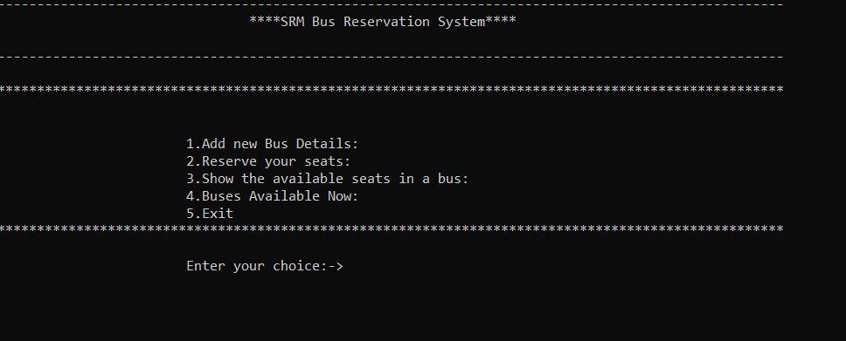
Main menu

Slide 8
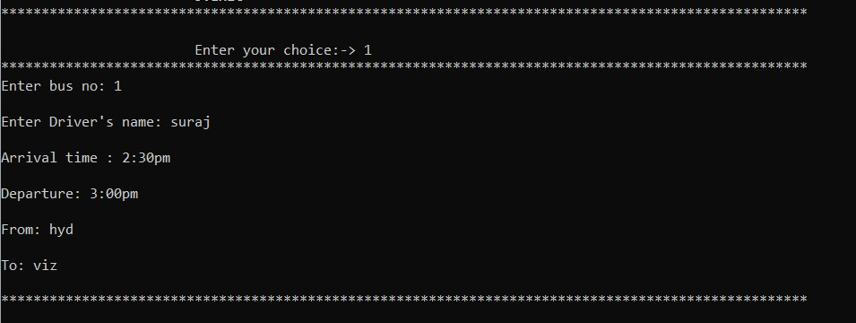
Add new bus details

Slide 9
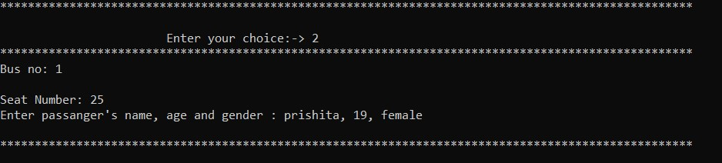
Reserve your seats

Slide 10
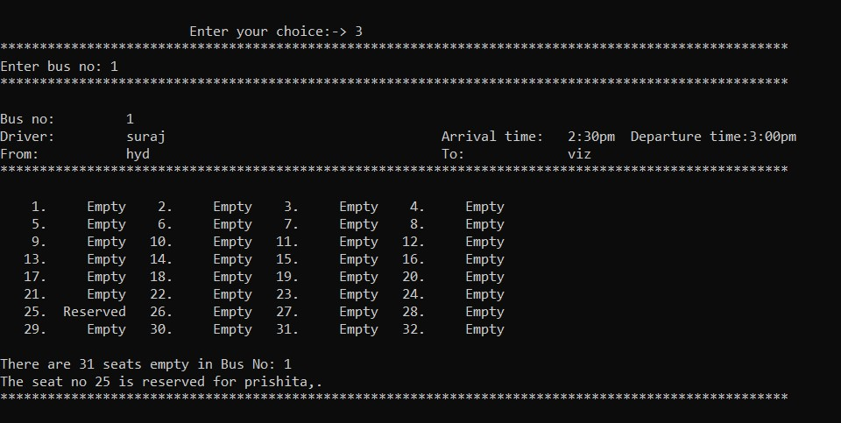
Show the available seats in a bus

Slide 11
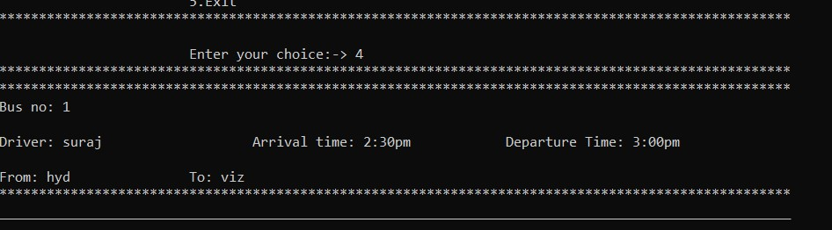
Buses available now

Slide 12
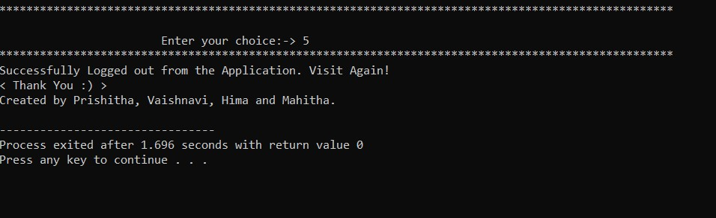
Exit

Slide 13
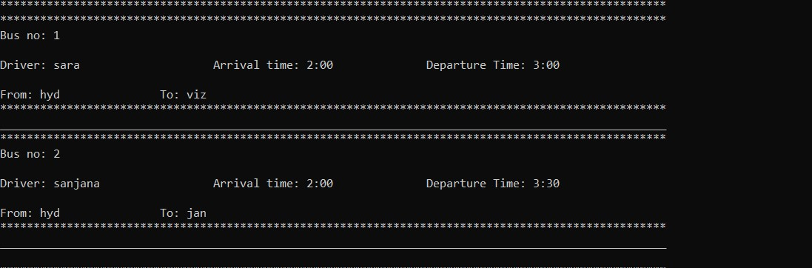
More than one bus details

Slide 14
CONCLUSION
The project- SRM Bus Reservation System has been a great learning experience for all of us, we have learned a lot of new concepts with the help of this project.
We have used OOPS concept i.e. class concept , to reduce the complexity of the program and by which every user can understand the code very easily.
While developing this project, we used the concepts of classes, Arrays, and functions.
The project has turned into reality through the combined efforts of our group.

Slide 15
Thank you
SUBMITTED BY:-
1. K.G.N PRISHITA(AP21110011542)
2. Vaishnavi P.S. (AP21110011543)
3. Hima Teja. G (AP21110011548)
4. Mahitha. V(AP21110011552)
Under the guidance of
Prof. Abhinash Pujahari

